Slide 1
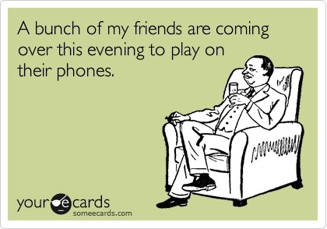
Satire
What is it and why is it awesome!!??

Slide 2
Purpose of Satire:
To engage, entertain, and evoke emotion.
To cause the reader to reflect on Society’s vices.
To incite social action through humor.

Slide 3
~ “the use of ridicule or scorn, often in a humorous way, to expose vices” ~ Satire “… uses irony, wit, and sometimes sarcasm to expose human vices, giving impetus (a driving force) to change or reform through ridicule.”
What is satire?

Slide 4
Bottom line: satire is poking fun at something to show how stupid it really is

Slide 5
Talk and Turn
What is being satirized in the video clip?

Slide 6
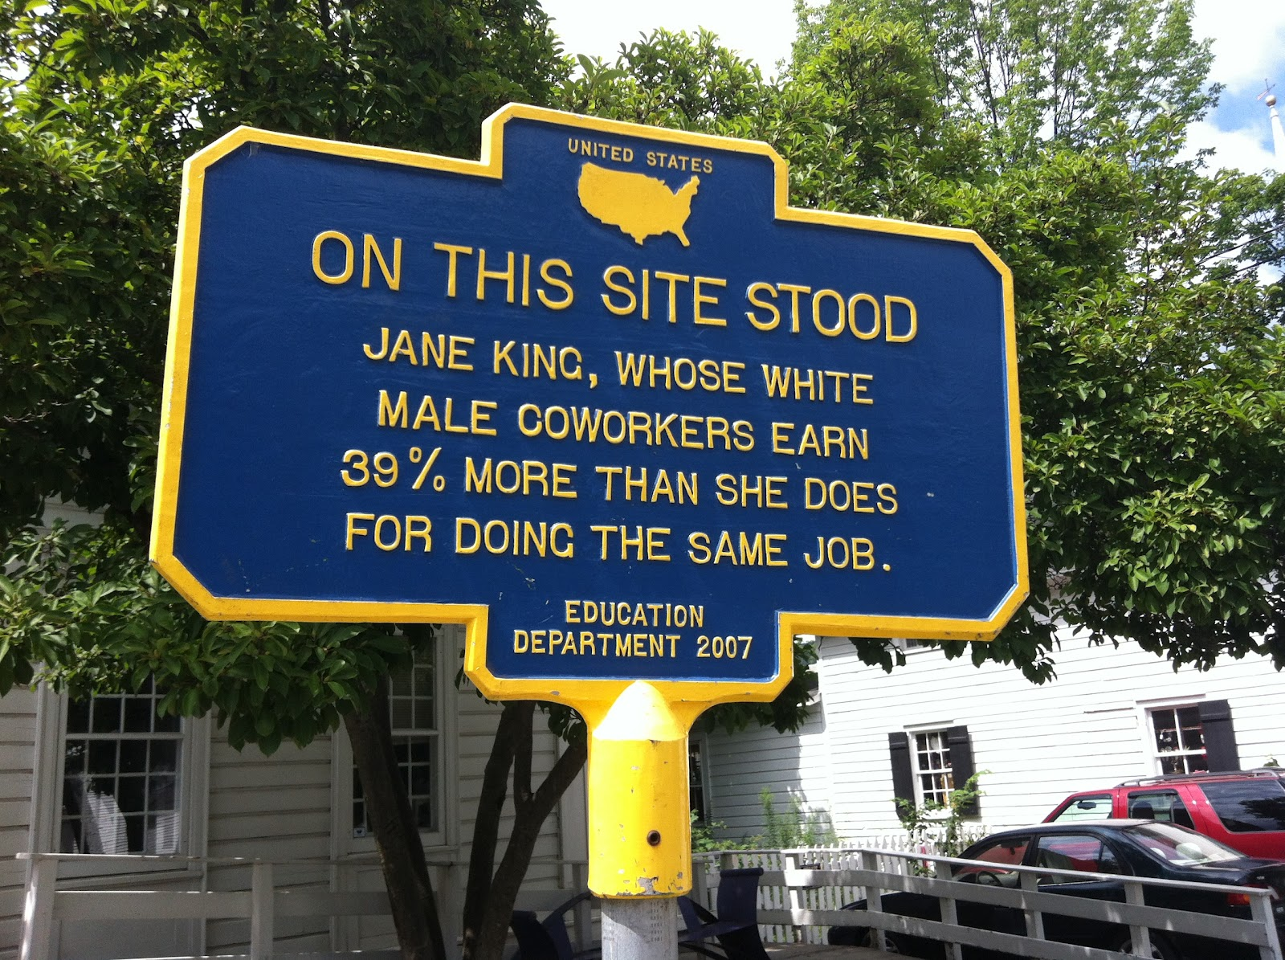
Two Main Categories of Satire:

Slide 7
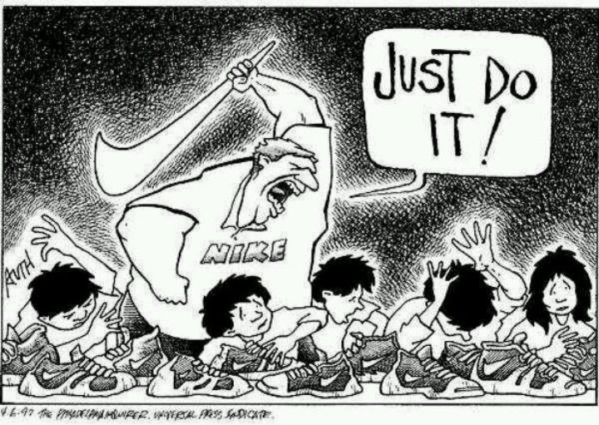
Juvenalian Satire
Biting, bitter, angry, points with contempt and moral indignation to the corruption and evil of human beings and their institutions.

Slide 8
What does the title mean?
Who are these people?
What is the significance of this date?

Slide 9
What is this clip Satirizing?

Slide 10
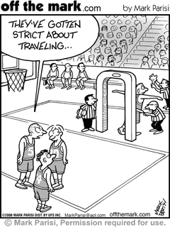
Horatian Satire
Gentle and humorous; aims to correct apparent wrongs by gently and broadly pointing out society’s mistakes.

Slide 11
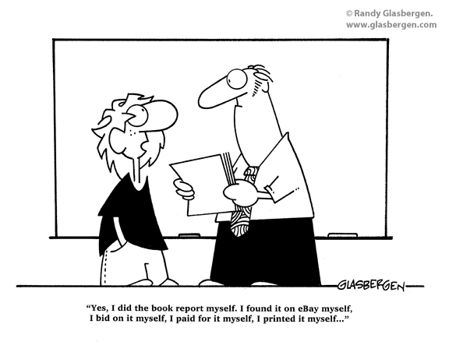
Homework:
Go to Educanon
and complete
the “Satire” lesson.

